Slide 1
Data Visualization in R
Vasim Shaikh
Day 2, Rave Tech
Notes:
options(scipen=999) # turn-off scientific notation like 1e+48

Slide 2
Topics
Grammer of Graphics (ggplot2)
Interactive visualization (plotly)
Few extensions
Basic of shiny
Human remember 80% of what they see.

Slide 3

Grammer of Graphics (ggplot2)
Let’s visualize

Slide 4
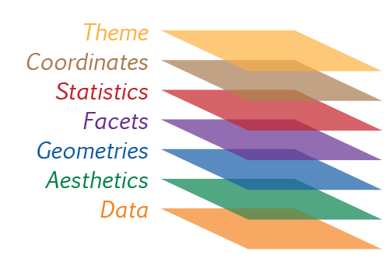
Elements of ggplot
Essential Elements
Data
Aesthetics
Geometry
Non Essential Elements
Facets
Statistics
Coordinates
Themes

Slide 5
Template
Ggplot(data = < DATA >) +
< GEOM FUNCTION > (mapping = aes( < MAPPINGS >))
*Template for starting purpose only
Notes:
ggplot(data = mpg)

Slide 6
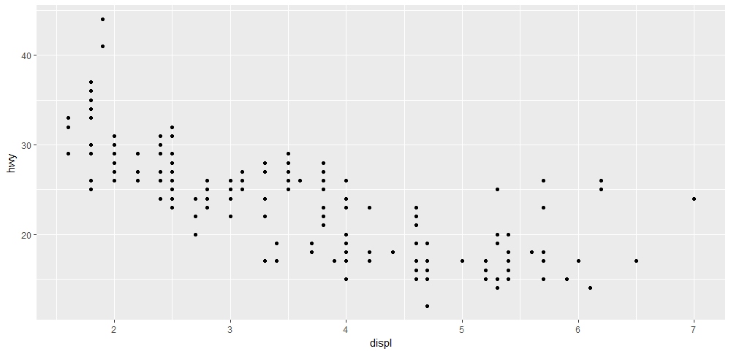
Do cars with big engines use more fuel than cars with small engines?
ggplot(data = mpg) + geom_point(mapping = aes(x = displ, y = hwy))

Slide 7
Exercise
Is there any relation between productivity and time spent in office?
How has attrition performed over the year?

Slide 8
AESTHETICS (Attributes!)
Aesthetic | Description
X | X axis position
Y | Y axis position
Colour | Colour of dots, outlines of other shapes
Fill | Fill colour
Size | Diameter of points, thickness of lines
Shape | Shape
Alpha | Transparency
LineType | Line dash pattern
Label | Text on a plot or axes

Slide 9
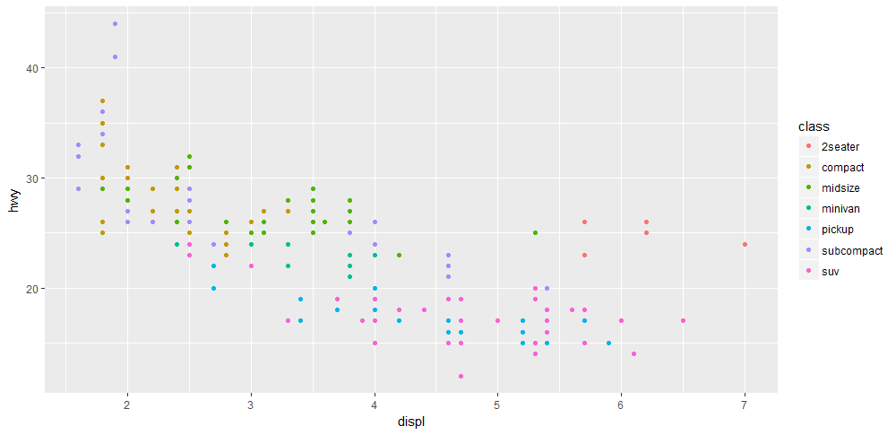
Distribution by aesthetic
ggplot(data = mpg) +
geom_point(mapping = aes(x = displ, y = hwy, col = class))
What if we use size, alpha or shape
aesthetic for mapping class variable?

Slide 10
Exercise
Relationship between productivity and office hours by department?
Distribution of net profit by region

Slide 11
Apply aesthetic manually
ggplot(mpg) + geom_point(aes(x = displ, y = hwy), color = "blue")
Same as
ggplot(mpg, aes(x = displ, y = hwy)) + geom_point(color = "blue")
*outside of aes() & global mapping

Slide 12
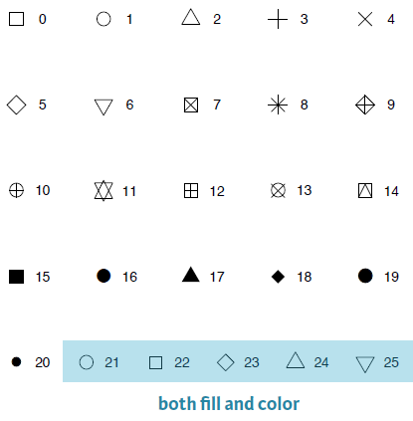
Shape Aesthetic

Slide 13
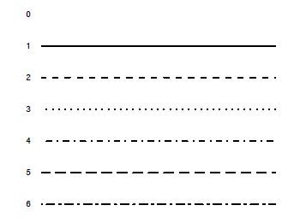
Line Type - Aesthetic

Slide 14
Ggplot Labels
ggplot(data = mpg) +
geom_point(mapping = aes(x = displ, y = hwy)) +
labs(title = "Title goes here", subtitle = "Subtitle here", x = "Display", y = "Highway")

Slide 15
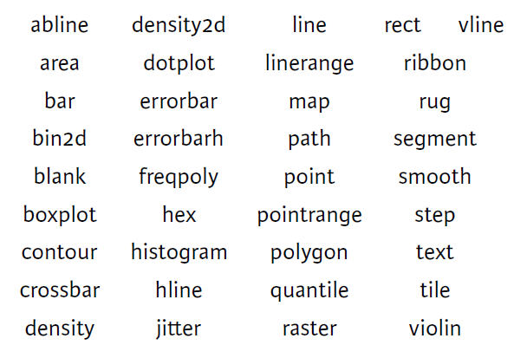
30+ Geom Functions
*Can be increased with extension packages

Slide 16
Multiple plot
ggplot(data = mpg) + geom_point(mapping = aes(x = displ, y = hwy)) + geom_smooth(mapping = aes(x = displ, y = hwy))
*Each geom has specific aesthetic mappings

Slide 17
Multiple plot
ggplot(leavers, aes(x = Month, y = Percentage)) + geom_point() +
geom_line()
*Set global mappings

Slide 18
Exercise
Add a vertical average line to attrition chart with linetype = 2

Slide 19
Facets
Split plot into facets.
View Dimensions of your data
Facet_wrap
Facet_grid

Slide 20
Facet wrap – by single variable
ggplot(data = mpg) + geom_point(mapping = aes(x = displ, y = hwy)) + facet_wrap(~ class, nrow = 2)

Slide 21
Facet grid – by two variable
ggplot(data = mpg) + geom_point(mapping = aes(x = displ, y = hwy)) + facet_grid(drv ~ cyl)
*Use dot (.) to view single dimension

Slide 22
Statistics
Stat_summary

Slide 23
Bar Chart
Bar Chart has a default statistic of count
Check if stat identity is required

Slide 24
Position Aesthetics
identity
dodge
stack
fill
jitter
jitterdodge

Slide 25
Coordinates
Skip

Slide 26
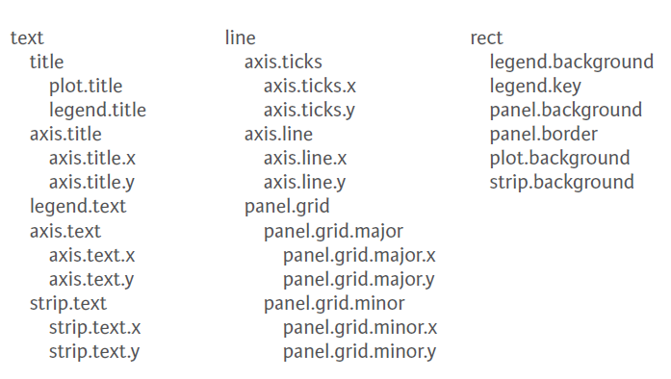
Themes

Slide 27
Ggthemes – 14 ggplot themes
Theme_base
Theme_calc
Theme_economist
Theme_excel
Theme_few
Theme_fivethirthyeight
Theme_gdocs
Theme_hc
Theme_par
Theme_pander
Theme_solarized
Theme_stata
Theme_tufte
Theme_wsj
https://github.com/jrnold/ggthemes
https://github.com/cttobin/ggthemr

Slide 28
Ggplot box

Slide 29
Colour your chart

Slide 30
A Publishable chart

Slide 31
Ggplot cheatsheet

Slide 32
Exercise

Slide 33
Interactive Graphs(Plotly)
Let’s interact

Slide 34
Plotly syntax
Plot_ly(mpg, x = ~displ, y = ~hwy) %>% add_markers(symbol = ~class)
Plot_ly(mpg, x = ~displ, y = ~hwy) %>% add_markers(color = ~class)
*Read message printed by plotly library.

Slide 35
Plotly
plot_ly(mpg, x = ~displ, y = ~hwy) %>% add_markers(color = ~class)
Same as
plot_ly(mpg, x = ~displ, y = ~hwy, type = "scatter")

Slide 36
Plotly charts (geoms)
add_area
add_pie
add_bars
add_histogram
add_histogram2d
add_heatmap
add_contour
add_boxplot
add_trace
add_markers
add_text
add_paths
add_lines
add_segments
add_polygons
add_ribbons
add_surface
add_mesh
add_scattergeo
add_choropleth

Slide 37
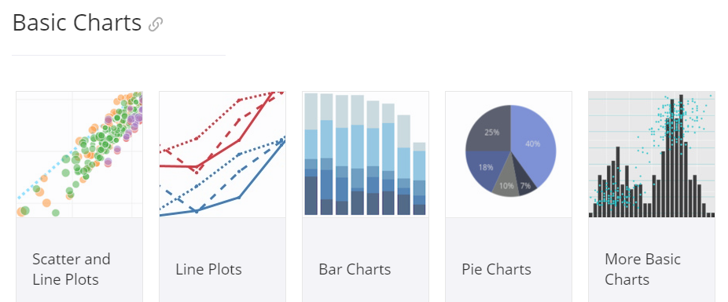
Plotly basic chart
https://plot.ly/r/#basic-charts

Slide 38
AESTHETICS (Attributes!)
Shape becomes symbol; Colour becomes color
#Colour from data frame column
plot_ly(iris, x = ~Sepal.Width, y = ~Sepal.Length) %>%
add_markers(color = ~Species)
#Manual color
plot_ly(iris, x = ~Sepal.Width, y = ~Sepal.Length) %>%
add_markers(color = ~Species, colors = c("red", "blue", "green"))

Slide 39
Color Aesthetic
#From RColorBrewer
plot_ly(iris, x = ~Sepal.Width, y = ~Sepal.Length) %>%
add_markers(color = ~Species, colors = "Set1")
plot_ly(iris) %>% add_markers( x = ~Sepal.Width, y = ~Sepal.Length, color = I("blue"))

Slide 40
Pie Chart
city_data %>% plot_ly(values = ~Emp) %>% add_pie(text = ~City)
city_data %>% plot_ly(values = ~Emp) %>% add_pie(text = ~City, hoverinfo = "none")

Slide 41
Add trace / secondary line
plot_ly(city_data) %>%
add_bars(x = ~City, y = ~Salary, name = "Salary") %>%
add_bars(x = ~City, y = ~Emp, name = "Employees") %>%
layout(barmode = "stack")

Slide 42
Shared Data

Slide 43
Events

Slide 44
Add Subplot
a <- plot_ly(diamonds, x = ~cut, y = ~price) %>% add_boxplot()
b <- plot_ly(iris, x = ~Species, y = ~Sepal.Length) %>% add_boxplot()
subplot(a,b) %>% hide_legend()

Slide 45
Chart Layout
Create xaxis and its parameters
Similarly yaxis and its parameters
Good online reference
https://plot.ly/r/reference/

Slide 46
Chart Labels
plot_ly(iris) %>%
add_markers( x = ~Sepal.Width, y = ~Sepal.Length, color = ~Species) %>%
layout(title = "This is a title", xaxis = list(title = "X label Here"), yaxis = list(title = "Y label here"))

Slide 47
GGPLOTLY()
Convert ggplot2 to plotly

Slide 48
Add ons
Let’s visualize

Slide 49
Scatter plot matrix (Pairs)

Slide 50
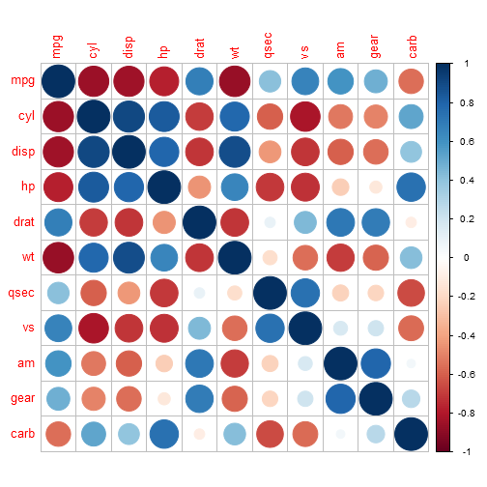
Correlation Matrix
https://plot.ly/r/reference/
library(corrplot)
M <- cor(mtcars)
corrplot(M, method="circle")
Method = circle, square, ellipse, number, shade, color, pie
Layout = upper, lower

Slide 51
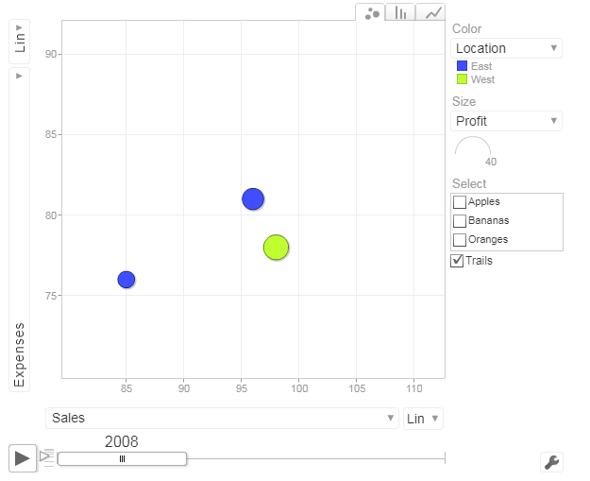
Google Visualization
Motion <- gvisMotionChart(Fruits, idvar="Fruit", timevar="Year")
plot(Motion)
https://cran.r-project.org/web/packages/googleVis/vignettes/googleVis_examples.html

Slide 52
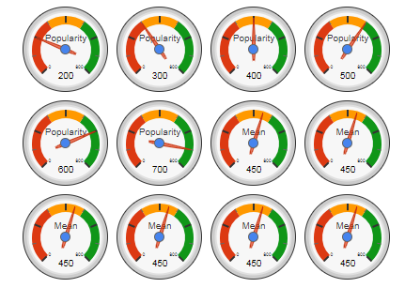
Google Visualization
Gauge <- gvisGauge(CityPopularity,
options=list(min=0, max=800, greenFrom=500, greenTo=800, yellowFrom=300, yellowTo=500, redFrom=0, redTo=300, width=400, height=300))
plot(Gauge)

Slide 53
Ggiraph (delete)
geom_bar_interactive
geom_boxplot_interactive
geom_line_interactive
geom_map_interactive
geom_path_interactive
geom_point_interactive
geom_polygon_interactive
geom_rect_interactive
geom_segment_interactive
geom_text_interactive
geom_tile_interactive
http://davidgohel.github.io/ggiraph/

Slide 54
Ggiraph Aesthetics (delete)
Tooltip
Onclick
Data_id

Slide 55
Shiny Web Application
Starter Pack

Slide 56
What is Shiny?

Slide 57
What is Shiny Server

Slide 58
What the new R-Connect?

Slide 59
Template and shortcut
library(shiny)
ui <- fluidPage()
server <- function(input, output, session){}
shinyApp(ui = ui, server = server)
Tools – Global options – Code – Edit Snippets – R – paste the above code

Slide 60
Basic App

Slide 61
Basic Tips and Tricks
Split code for large shiny codebase
Start and stop Shiny
Run shiny on a different port
Set filepath function

Slide 62
Thanks!
Any questions?
cv.vasim@gmail.com

Slide 63
Prepare a chart
Is there any relation between productivity and time spent in office?
How much work is allocated to whom?
How has attrition performed over the year?

Slide 64
Instructions for use
EDIT IN GOOGLE SLIDES
Click on the button under the presentation preview that says "Use as Google Slides Theme".
You will get a copy of this document on your Google Drive and will be able to edit, add or delete slides.
You have to be signed in to your Google account.
EDIT IN POWERPOINT®
Click on the button under the presentation preview that says "Download as PowerPoint template". You will get a .pptx file that you can edit in PowerPoint.
Remember to download and install the fonts used in this presentation (you’ll find the links to the font files needed in the Presentation design slide)
More info on how to use this template at www.slidescarnival.com/help-use-presentation-template
This template is free to use under Creative Commons Attribution license. You can keep the Credits slide or mention SlidesCarnival and other resources used in a slide footer.

Slide 65
Hello!
I am Jayden Smith
I am here because I love to give presentations.
You can find me at @username

Slide 66
Transition headline
Let’s start with the first set of slides

Slide 67
Quotations are commonly printed as a means of inspiration and to invoke philosophical thoughts from the reader.

Slide 68
This is a slide title
Here you have a list of items
And some text
But remember not to overload your slides with content
Your audience will listen to you or read the content, but won’t do both.

Slide 69
BIG CONCEPT
Bring the attention of your audience over a key concept using icons or illustrations

Slide 70
You can also split your content
White
Is the color of milk and fresh snow, the color produced by the combination of all the colors of the visible spectrum.
Black
Is the color of coal, ebony, and of outer space. It is the darkest color, the result of the absence of or complete absorption of light.

Slide 71
In two or three columns
Yellow
Is the color of gold, butter and ripe lemons. In the spectrum of visible light, yellow is found between green and orange.
Blue
Is the colour of the clear sky and the deep sea. It is located between violet and green on the optical spectrum.
Red
Is the color of blood, and because of this it has historically been associated with sacrifice, danger and courage.

Slide 72
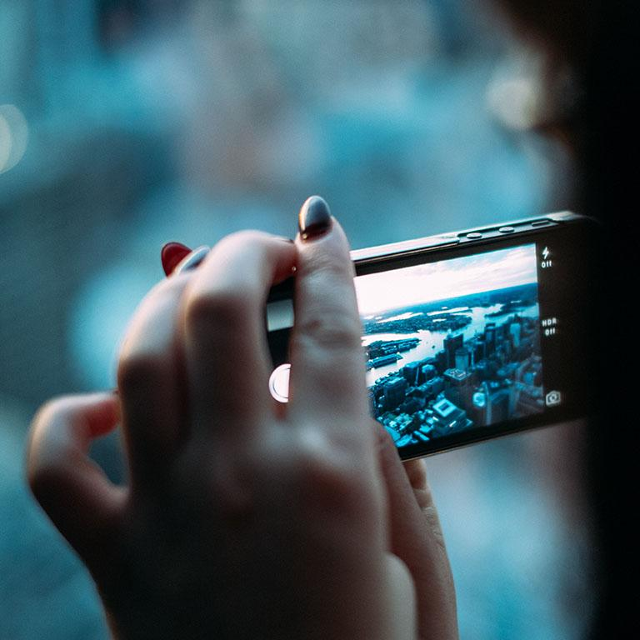
A picture is worth a thousand words
A complex idea can be conveyed with just a single still image, namely making it possible to absorb large amounts of data quickly.

Slide 73
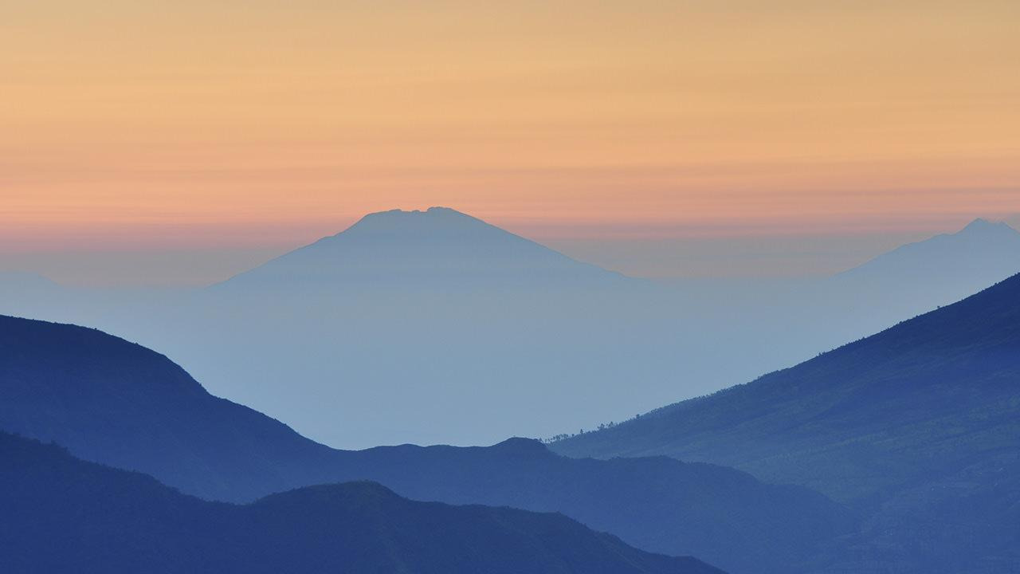
Want big impact? Use big image.

Slide 74
Use charts to explain your ideas
White
Gray
Black

Slide 75
And tables to compare data
 | A | B | C
Yellow | 10 | 20 | 7
Blue | 30 | 15 | 10
Orange | 5 | 24 | 16

Slide 76
Maps
our office

Slide 77
89,526,124
Whoa! That’s a big number, aren’t you proud?

Slide 78
89,526,124$
185,244 users
100%
That’s a lot of money
And a lot of users
Total success!

Slide 79
Our process is easy
first
second
last

Slide 80
Let’s review some concepts
Yellow
Is the color of gold, butter and ripe lemons. In the spectrum of visible light, yellow is found between green and orange.
Blue
Is the colour of the clear sky and the deep sea. It is located between violet and green on the optical spectrum.
Red
Is the color of blood, and because of this it has historically been associated with sacrifice, danger and courage.
Blue
Is the colour of the clear sky and the deep sea. It is located between violet and green on the optical spectrum.
Red
Is the color of blood, and because of this it has historically been associated with sacrifice, danger and courage.
Yellow
Is the color of gold, butter and ripe lemons. In the spectrum of visible light, yellow is found between green and orange.

Slide 81
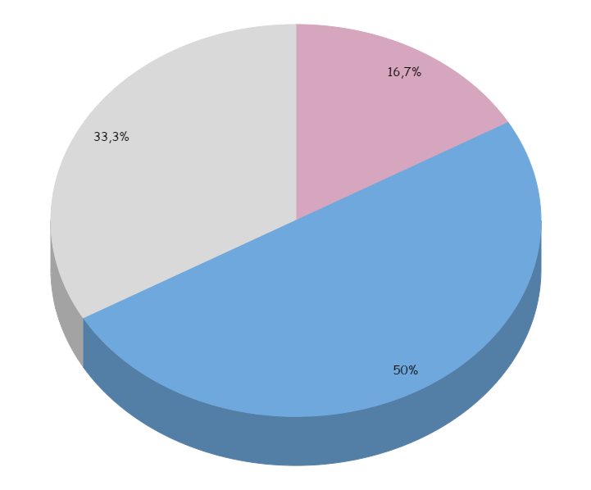
You can insert graphs from Google Sheets

Slide 82
Android project
Show and explain your web, app or software projects using these gadget templates.
Place your screenshot here

Slide 83
iPhone project
Show and explain your web, app or software projects using these gadget templates.
Place your screenshot here

Slide 84
Tablet project
Show and explain your web, app or software projects using these gadget templates.
Place your screenshot here

Slide 85
Desktop project
Show and explain your web, app or software projects using these gadget templates.
Place your screenshot here

Slide 86
Thanks!
Any questions?
You can find me at:
@username
user@mail.me

Slide 87
Credits
Special thanks to all the people who made and released these awesome resources for free:
Presentation template by SlidesCarnival
Photographs by Unsplash

Slide 88
Presentation design
This presentation uses the following typographies and colors:
Titles: Patrick Hand SC
Body copy: Sniglet
You can download the fonts on these pages:
https://www.fontsquirrel.com/fonts/sniglet
http://www.1001freefonts.com/patrick_hand_sc.font
You don’t need to keep this slide in your presentation. It’s only here to serve you as a design guide if you need to create new slides or download the fonts to edit the presentation in PowerPoint®

Slide 89
SlidesCarnival icons are editable shapes.
This means that you can:
Resize them without losing quality.
Change fill color and opacity.
Isn’t that nice? :)
Examples:

Slide 90
😉
Now you can use any emoji as an icon!
And of course it resizes without losing quality and you can change the color.
How? Follow Google instructions https://twitter.com/googledocs/status/730087240156643328
✋👆👉👍👤👦👧👨👩👪💃🏃💑❤😂😉😋😒😭👶😸🐟🍒🍔💣📌📖🔨🎃🎈🎨🏈🏰🌏🔌🔑 and many more...

